Slide 1
Blender Project
Team Q
Rise and Fall
David Orlando de la Fuente Garza - A00817582
José María Flores Escalera - A01153458
Diego Adolfo José Villa - A00815260

Slide 2
Introduction

Slide 3
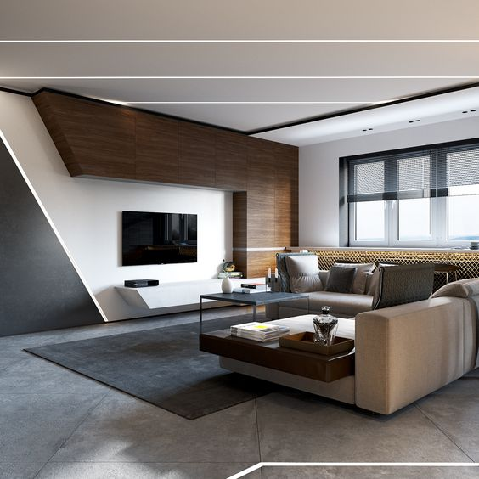
Inspiration for the Scene

Slide 4
Introduction
We wanted to create a living room consisting of elements such as tables, a TV, books, sofas, etc.
But a normal living room is boring, so we added elements to exemplify the relation between art and the modern era.
Using modern elements we wanted to show how technology is impacting our way of living and how we react to our emotions.

Slide 5
Introduction
Also, our version of the living room will try to show how modernity has negatively impacted the love for literature and art, which may be forgotten in the battle against electronic media and cheap entertainment that is common on our daily lives.

Slide 6
Modelling

Slide 7
List of Original Models
IN ORDER TO BRING TO LIFE THE SCENE, WE NEEDED THE FOLLOWING ELEMENTS WHICH WE MODELED OURSELVES:
Walls, floor, roof and wall relief.
A Carpet
A Main Table
Table lights
Chairs
Book shelves
A TV
Sphere decorations
Books
A Lighter
An Ashtray
Windows (with the help of a plug-in)

Slide 8
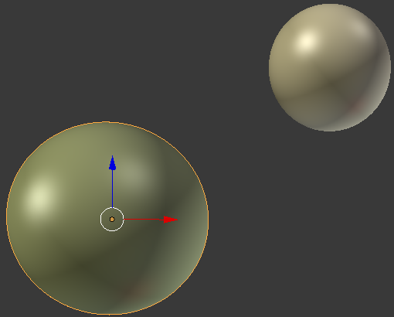
Modelling – SPHERE DECORATIONS
We useD primitive meshes To generate the Sphere decorations models.
In order to give them a realistic feeling, we applied a glass texture alongside golden colors.
Two of them were created to be similar to common table and shelves decorations USING THE SCALE FUNCTION TO GIVE THEM THEIR CORRESPONDING SIZE AND GEOMERTRY.

Slide 9
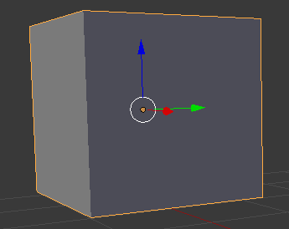
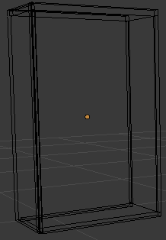
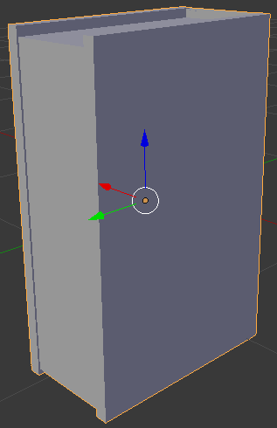
Modelling – books
In order to create a well modelled book, we used the primitive cube mesh and started to pick vertices and extruding in order to give it a book shape, making the inner sides of the book a bit deeper than its MOLD. We also made sure to make the BOOK model look like it had a cover and pages on its inner sides.
We duplicated the mesh a few times to fill the bookshelf cabinets and started playing with the translation tool to find an interesting position for them so their placement wouldn’t look boring.

Slide 10
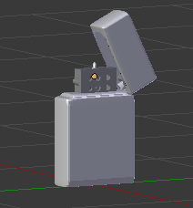
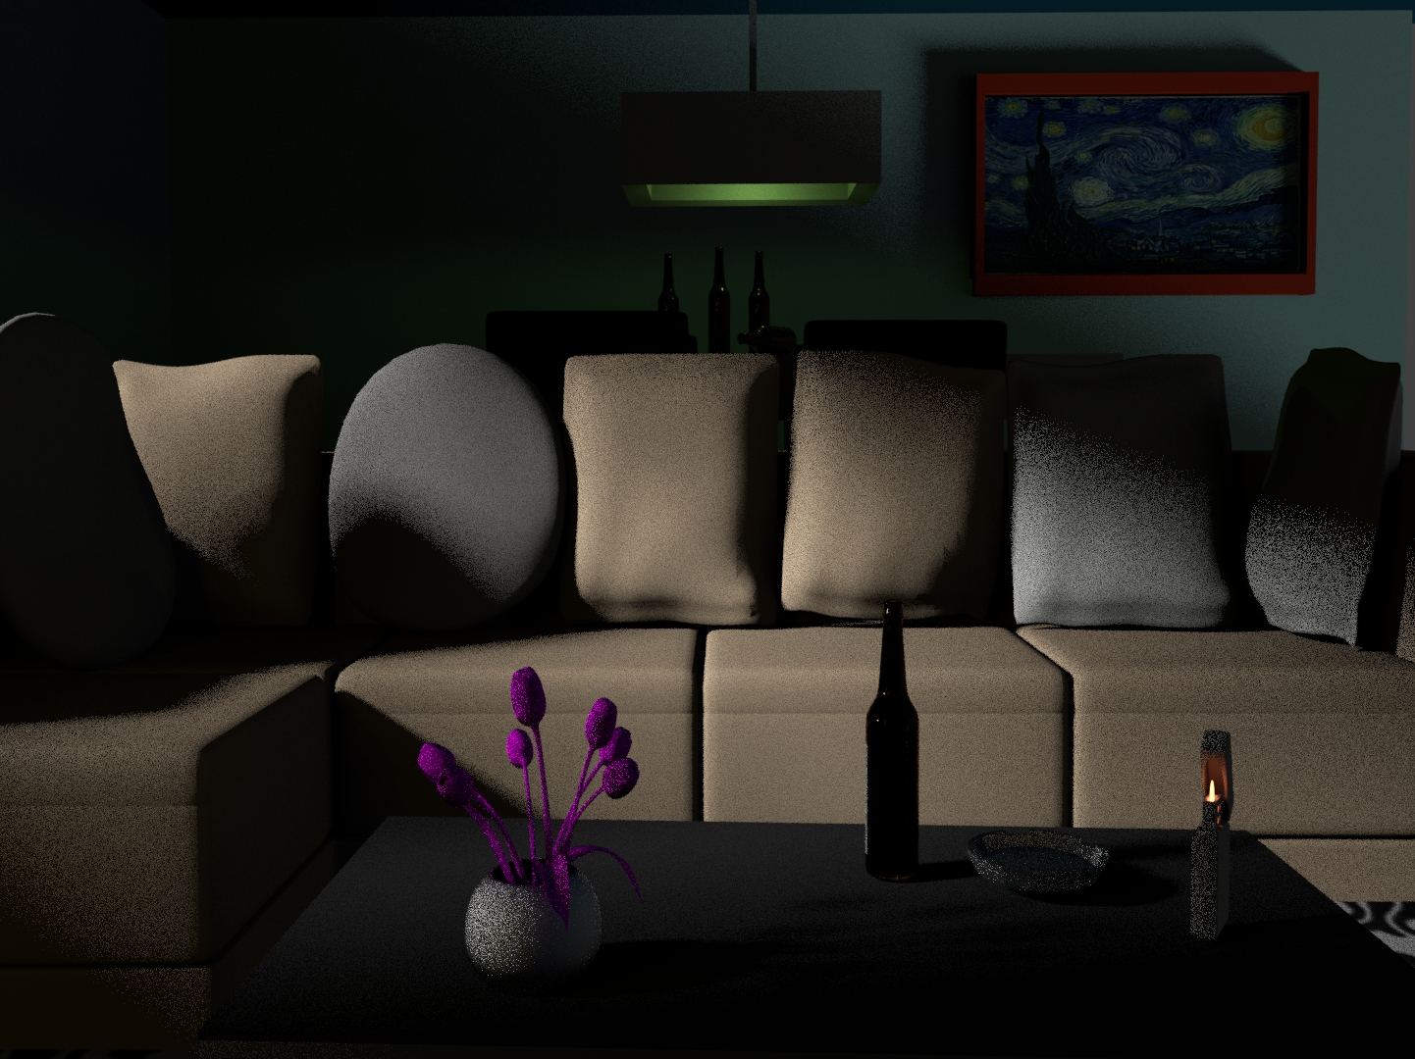
Modelling - Lighter
To model the lighter we used basic geometric forms like cubes and cylinders.
We started the modelling with a cube and we applied a surface modifier to get an object with rounded borders. To adjust the degree of curvature of rounded borders we used the option edged loops.
For the other elements we also used basic cubes, but to create the spaces without volume we used the boolean modifiers for union and difference.
To get the flame first we created a cylinder and we applied the surface modifier to get an object with all curved edges, next we changed the Blender Render to Cycles Render, that change allow us to selected a surface of emission in the material section.
To simulate the flame we adjusted the values for color and intensity.

Slide 11
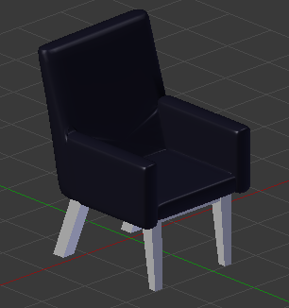
Modelling - Chair
To create the chair for the dinner table we started with a plane mesh, next we extruded it to get the desired height. We played with moving the vertices and edges to get pieces with sloping sides.
To get the rounded borders, we used a surface modifier and we adjusted them using edged loops.
To join the different components of the chair, we used the boolean modifier of union, with this we obtained a similar effect to two pieces of leather joined.
For the legs we used cubes and we adjusted their dimensions.
For the materials we used solid colours.

Slide 12
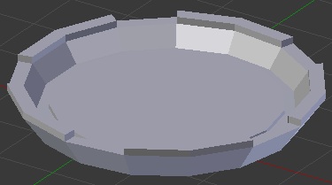
Modelling - Ashtray
To model the ashtray we followed the same process of the wine glass learned during a homework.
We started with a vertex point and we extruded it several times to get a basic form of the ashtray. Next, we used the spin option with 15 steps to get a solid form.
We applied extrude to some faces to get a more realistic piece.

Slide 13
List of Imported Models
A few objects within the scene were too complicated to model within the timeframe given so they were imported from outside sources:
A Sofa
Cushions
A Small table in front of the sofa
Beer bottles
Flowers in a vase
A Statue decorating the book shelves
All of them were taken with authorization within Creative Commons from Blend Swap and are credited at the end of this presentation in order to give them their full description.

Slide 14
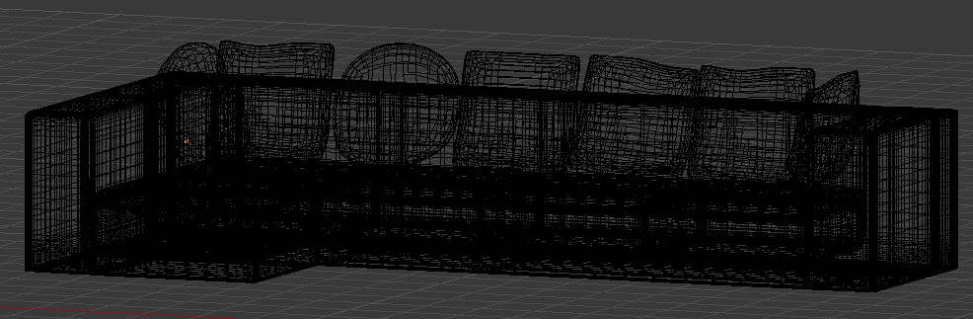
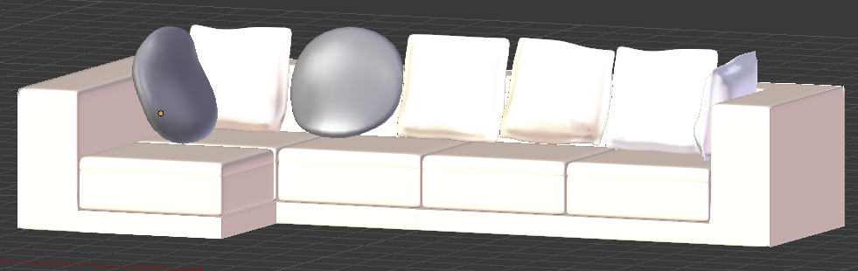
Main Imported Models - Sofa
One of the main object’s geometries, we further explain its location in layout and composition:

Slide 15
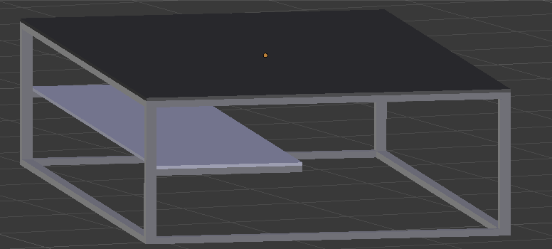
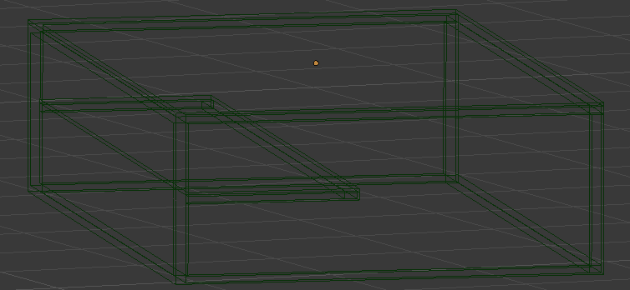
Main Imported Models – TABLE IN FRONT OF SOFA
One of the main object’s geometries, we further explain its location in layout and composition:

Slide 16
Layout and Composition
The general layout is a common living room where people can enjoy a TV show or eat from the main table. The main focus is the space between the TV and the sofa and their immediate surroundings areas.
Both objects are facing each other while the window, the main source of light, is perpendicular to both. The size and texutres used of the objects within the scene gives them a realistic look compared to a normal living room.

Slide 17
Layout and Composition
The TV is placed on the wall alongside bookshelves with a sofa far FROM IT to protect the viewer from the damage to their eyes from seeing it too close.
There’s a small table closer to the sofa so it's easier to place and pick up food and drinks.
THE BOOKSHELVES ARE PLACED TO A SIDE OF THE tv, facing the sofa FROM THE SAME DISTANCE AS THE TV, so the people living in the house can enjoy a different kind of entertainment. They Are big enough to CONTAIN DIFFERENT OBJECTS like BOOKS, statues and decorations. We GAVE THEM A YELLOWISH COLOR texture AS THEY WERE PAINTED IN REAL LIFE.

Slide 18
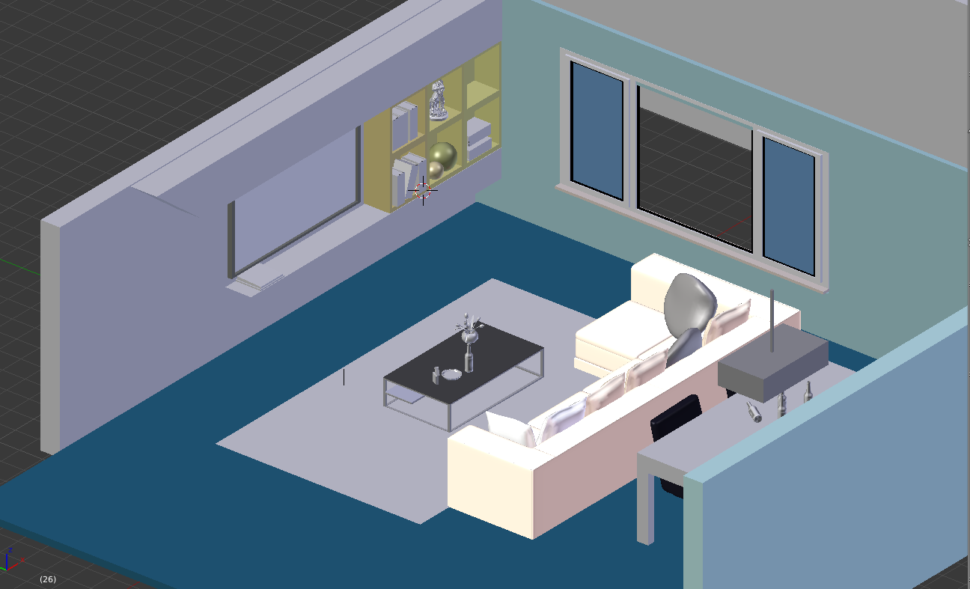
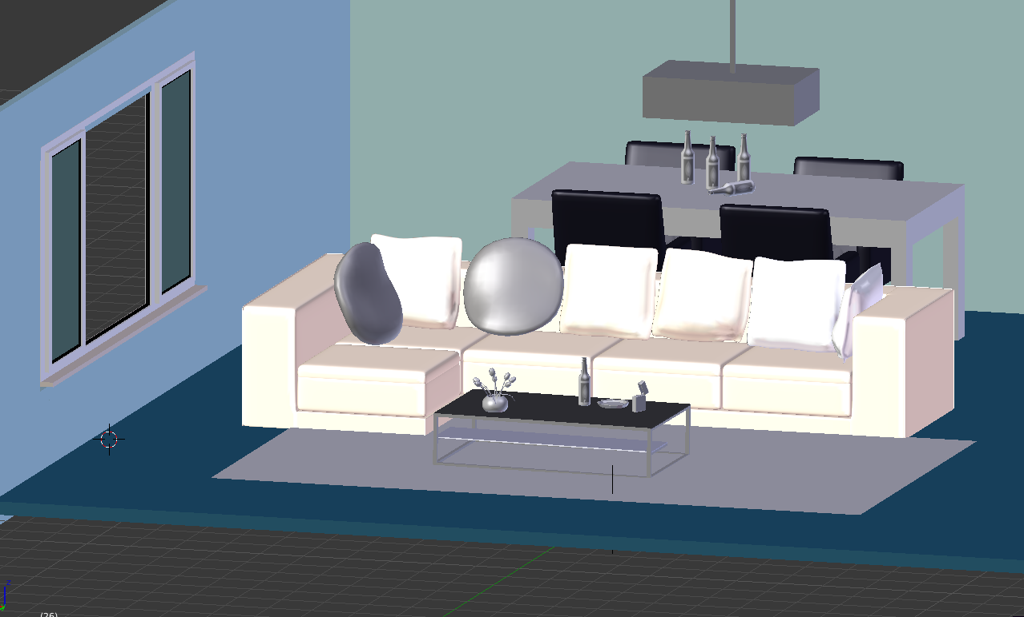
Layout and Composition
A look into ALL the models’ location, size, orientation and distance to others without textures.

Slide 19
Important Elements
We added to following elements to help us to transmit our message:
A plant that represents our planet and it was placed at the corner of the table to demonstrate that many people don’t care about the environment compared to being agreeably occupied.
A cigarette lighter to represent the addictions, destruction and vices of the world. The lighter is on because we wanted to represented global warming and the huge amounts of smoke thrown into the environment every day.

Slide 20
Important Elements
Beer bottles to represent the alcohol addiction and how this is one of the most common problems with young people.
A TV to represent how the digital world is impacting the way we react to personal and global problems. It also represents how the information has been manipulated and how we blindly believe what we’re told.
Books and art pieces in the corners of the room to represent how knowledge and culture are becoming less relevant in our life.

Slide 21
Cameras

Slide 22
Illumination
We used several sources and kinds of illumination, each one with a specified purpose:
Top-right corner of bookshelf: Create shadows and illusion of darkness inside the room.
Spotlights (either a small lamp or the flash of the TV powering on/off): Used to highlight the importance of certain elements and how even if overshadowed, are still important to the scene.

Slide 23
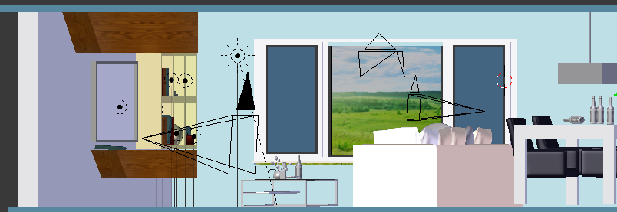
Illumination

Slide 24
Cameras
We used cameras to show different angles, each one with an unique idea. The three principal ideas were:
Take of the whole room: Give general landscape of room and outside.
Take from the TV to the back of the room: Show how art has been forget.
Take in front of bookshelf: Show the importance art and literature still have.

Slide 25
The Scene

Slide 26
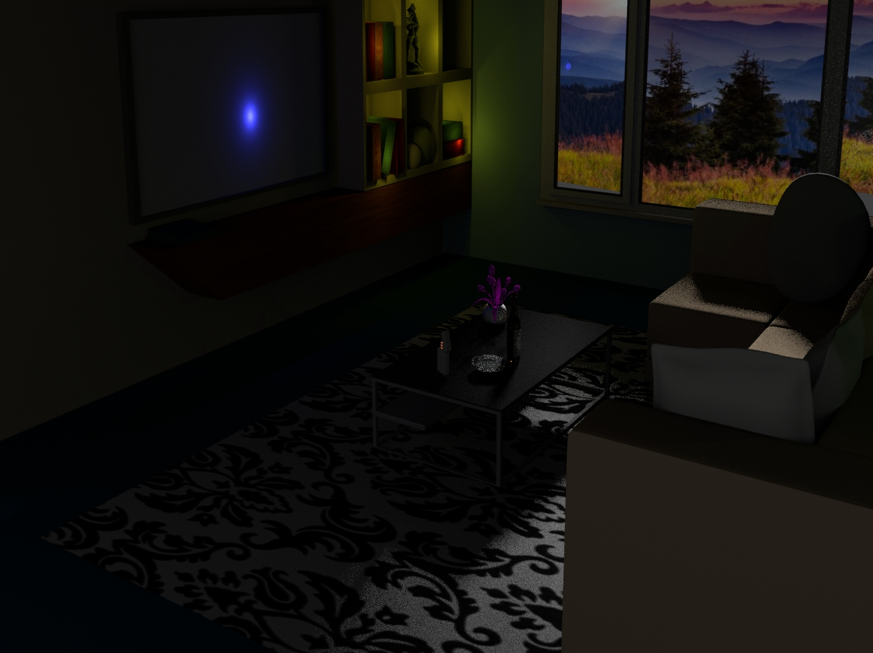
Image 1: Art and literature forgotten on the corner, but still relevant to society.

Slide 27
Image 1: Art and literature forgotten on the corner, but still relevant to society.
In this view we set up the camera in such a way as to give us a general perspective of the principal elements of our scene.
We used the lights properties in such a way as to provide a dark and mysterious atmosphere.
We put a blue light on the screen to represent a similar effect when you turn on the TV.
We used a warm light to illuminate pieces of art and books. We wanted to illustrate how we are forgetting to integrate these elements into out lives.

Slide 28
Image 1: Art and literature forgotten on the corner, but still relevant to society.
We placed our main lighting point according to the image we used to represent the exterior environment of our scene.
The main light and the background image allowed us to create a perfect atmosphere were the shadows are very important to communicate the intention of a mysterious feeling.

Slide 29
Image 2: A piece of art with shadows on the back of the scene.
Shows how society is giving its back to art, focusing in vies like drinkiing, smoking and other addictions.

Slide 30
Image 2: A piece of art with shadows on the back show how society is giving the back to art.
In this view we set up the camera in such a way as to focus on what is happening at the tables, but we also wanted to focus the piece of art that is on the wall.
The main light still help us to make a mysterious scene through the shadows generated by the objects.
We used light to focus the beer bottles on the table. This light is cold and not very clear, this allows us to create a little interest on the table but we did not want this to be very eye-catching.

Slide 31
Image 2: A piece of art with shadows on the back show how society is giving the back to art.
We also used a very interesting light to project a very dim light in the direction of the art piece on the wall.

Slide 32
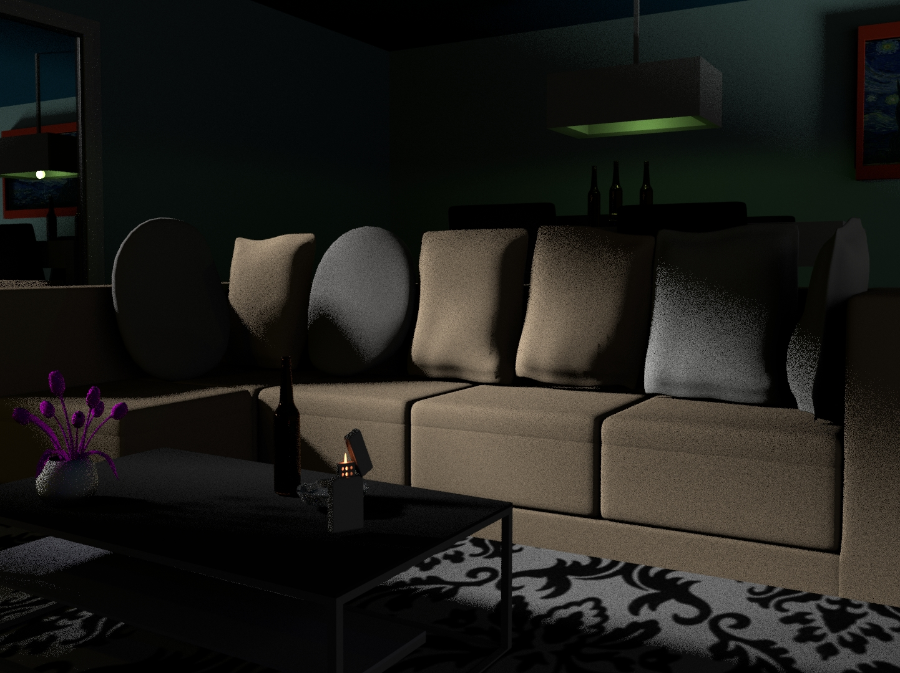
Image 3: Shows which objects we give more importance in our lives.

Slide 33
Image 3: Shows which objects we give more importance in our lives.
With this camera we wanted to continue reinforcing our scene of darkness and lighting in objects of interest like the light and beer bottles.
But we also wanted to focus another important element of our scene. On the left side of our scene we can see the reflect of the lamp, the beer bottles and the piece of art.
With the help of the lights we create another point of interest in the image. We wanted an effect that will simulate a mirror, we got this with the reflection of the lights in the window.

Slide 34
Image 3: Shows which objects we give more importance in our lives.
If we observe the lamp, we notice that we do not see a bulb, but if we see its projection in the window we will see that there is a bulb. We achieve this effect using the lights and reflections.
The overall purpose of this effect and the camera is to create the uncertainty of what is real. We project a different image of what we really are inside.

Slide 35
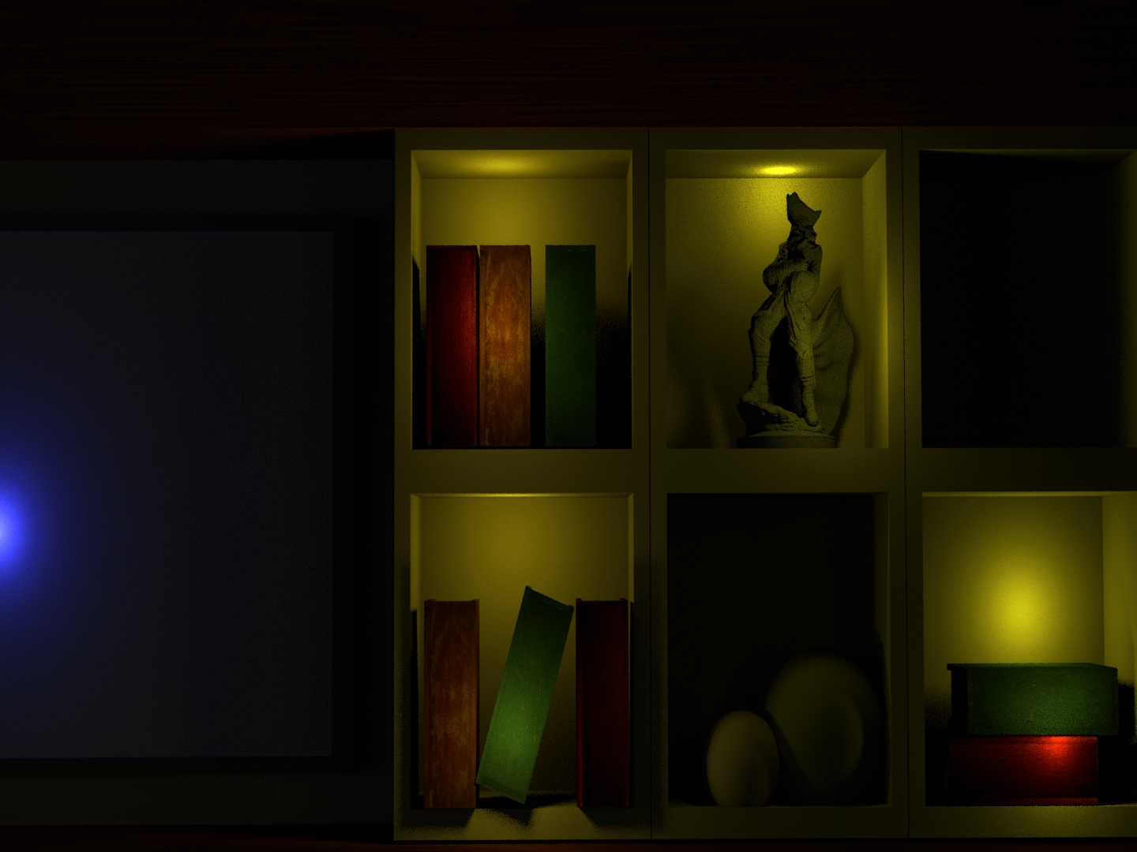
Image 4: Shows that even if forgotten, art and literature are CAN BE a source of enlightenment.

Slide 36
Image 4: Shows that even if forgotten, art and literature are the true source of enlightenment.
This is a complete image to achieve our intent. We wanted to show that knowledge is only in a corner of our personality and we achieve this intention through the low illumination and shadows effects.
We also leave a space without illumination to show that although we still have many resource to acquire knowledge we do not take advantage of them, we prefer to feed our mind with digital content.

Slide 37
Conclusions

Slide 38
Technical Conclusions
Some technical difficulties we found were mostly on textures, camera positioning and compositions. Using models from external sources was a challenge in istelf to texture properly and according to our scene as it was originally done with a much difficult way that the ones learned in class and in homeworks, making us search and learn different ways of doing it.
However, we found interesting the different features that each rendering option offers and the variety of compositions. Finding the right lighting and the right angle to show our work was also a very tiring but worthwhile task as we could see clearly our work take shape as we wanted it to do.
This Teamwork based project helped us put into practice the different lessons learned from the very beginning, contemplating all the topics reviewed. Also, this activity made us think critically about different subjects that might not seem at first hand related to the course, but can be a part of it if we PUT OUR CREATIVITY INTO IT.

Slide 39
Technical Conclusions
This way of approaching the Project made us discuss and find a common way of thinking to imagine the closed room to represent.
We found that the models, lighting, shadows, cameras and different tools can help shape and represent an idea within a closed room.
We would like to take part in projects with a similar approach if possible, as it is quite satisfactory to reach a common ground and see it take shape as we imagined it even if we face technical difficulties in our way there.

Slide 40
Ethical Conclusions
Our project tries to demonstrate the impact that modern life and technology have on our cultural context, Specifically in how an excess in pleasure could lead us to an hedonist life.
It also shows how the spontaneous pleasures are darkening the judgement of people, which is a cause of the shadowing of the art pieces, books and cultural artifacts like statues.
AS REPORTED ON HOY DIGITAL IN 2016, This new philosophy of the market of pleasure has created a phrase “live in a hurry, die young” Hence the love of speed, being a lover of sexual cycling: stimulating, energizing, drugs that increase the vigil and others that produce euphoria. You have to drink, smoke, eat everything and try everything. But you have to do it quickly: life is short, it goes away at any moment, and moments of happiness do not come back. (Retrieved from: http://hoy.com.do/vive-deprisa-muere-joven/)

Slide 41
Ethical Conclusions
This hedonist way of life can hinder our capabilities and desires, ignoring our moral responsibility to live within a society, looking out for people around us. Instead, this way of thinking is selfish and individualist as someone being led by it only cares about themselves. We should avoid living a hedonistic life.

Slide 42
Citizenship Conclusions
In our scene, we added elements like beers, a lighter and an ashtray. These elements with shadows and dark tones try to exemplify how society has been corrupted by vices and addictions.
Also, the setting of the scene being(closed and dark)relates with citizens worrying less and being less optimistic about doing something that could help the outside world and our society, preferring an individual way of living.
Currently, alcoholism is the most important problem of addictions in Mexico. this is alarming if we think that the age of Conset of alcohol consumption has decreased at the age of 12 years and has noticed an increase in the amounts consumed by women.

Slide 43
Citizenship Conclusions
According to the Pan-American Health Organization, alcohol consumption in Latin America increased, men consumed 1.6 times more than 5 years ago and women increased their consumption 2.8 times. (Retrieved from https://www.publimetro.com.mx/mx/destacado-tv/2017/01/17/alcoholismo-problema-creciente-mexico.html/)
This way of thinking AND ACTING ultimately doesn't solve society problems and may actually be the source of many.

Slide 44
Environmental Conclusions
At the table, we placed a cigarette lighter and a plant. For us, this is an abstraction of global warming. One important thing about this abstraction in our scene is that the cigarette lighter is on.
With the wick on, we want to represent that, although we have serious environmental problems, our efforts to change our habits are very small compared to the damage done on previous years.
We selected a cigarette lighter because the fire represents the chaotic nature of environmental problems and catastrophes led by the overconsumption of resources in our planet.

Slide 45
Environmental Conclusions
When we talk about forests globally, the two questions that we ask ourselves most are "How many trees are there on Earth?" And "How many fall each year?” A new report, based on a combination of satellite images, field inventories and virtual models, offers the answer to this last question: 15.3 billion are cut down each year from the 3 billion trees on the planet's surface. (Retrieved from http://rpp.pe/mundo/medio-ambiente/cuantos-arboles-son-talados-cada-ano-en-todo-el-mundo-noticia-974490)
We also have a purple flower, representing that it is made of plastic and thus fake, while the real nature is outside. With this, we try to show that no artificial element may ever truly have the same beauty and value as the real nature. We should try our hardest to protect and preserve the natural resource the world has given us.

Slide 46
Project Conclusions
We accomplished the purposes of our project as we:
Demonstrated how technology has showed a different perspective of the reality of people. We can see happy people but, inside their personal spaces, they show their real identity.
Showed how the digital era has displaced the different expressions of art.

Slide 47
Credits - Models
Glass bottle BY MARTON TAMAS, available under a Creative Commons Attribution-No Derivatives 4.0 International License at: https://www.blendswap.com/blends/view/68000
Plunderbuss Pete by Ben Dansie, available under a Creative Commons Zero License at https://www.blendswap.com/blends/view/69985
Sofa + Table + Pillow by Nikita, available under a Creative Commons Attribution-No Derivatives 4.0 International License at https://www.blendswap.com/blends/view/6605
Tulips BY Naman Aafle, available under a Creative Commons Attribution-No Derivatives 4.0 International License at: https://www.blendswap.com/blends/view/7418
Windows Generator 3, Blender add-on for creating windows by Anton ioya, Available at: https://github.com/Antonioya/blender/tree/master/add_window_3

Slide 48
Credits - Textures
Fondos de la naturaleza. [Imagen]. Recuerado de http://www.planwallpaper.com/static/images/nature_backgrounds_perfect_version_images_7035.jpg
Libro cubierta textura. [Imagen]. Recuperado de https://images.freecreatives.com/wp-content/uploads/2015/10/vintage-book-cover-texture.jpg.
Tapicería cuero botón textura oro. [Imagen]. Recuperado de https://thumbs.dreamstime.com/t/luxury-upholstery-leather-button-chair-texture-gold-40545970.jpg.
Textura acolchada en rojo [Imagen]. Recuperado de https://image.freepik.com/free-photo/red-quilted-texture_1048-1757.jpg.
Textura de madera. [Imagen]. Recuperado de http://img07.deviantart.net/97e4/i/2011/051/0/5/wood_grain_texture_4_by_hyenacub_stock-d3a1cr8.jpg.
Textura de roca. [Imagen]. Recuperado de http://cdn.designbeep.com/wp-content/uploads/2013/09/11.rock-texture.jpg.
Texturas libro de cuero. [Imagen]. Recuperado de http://www.texturepalace.com/gallery/book/2016-02-08-leather-book-cover/leather-book-textures--4.jpg.

